Slide 1
Learn JavaScript with fun, build an UFO hunter game Setting up development environment

Slide 2
Integrated Development Environments for JavaScript
Brackets
Atom
Komodo Edit
Netbeans
RJ TextEd
Light Table
Sublime Text
Visual Studio Code
and so on...

Slide 3
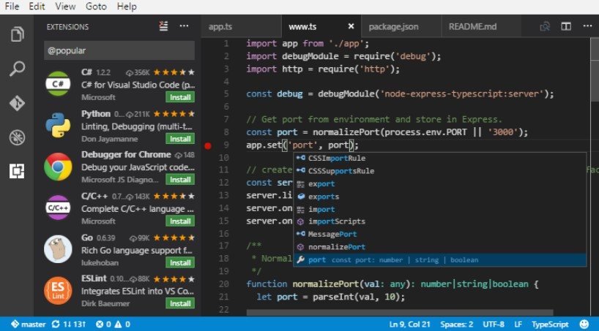
Visual Studio Code
Visual Studio Code is a lightweight but powerful source code editor which runs on your desktop and is available for Windows, Mac and Linux.
VS Code offers smart completion with IntelliSense, built-in Git integration, the ability to debug code straight from the editor, and more.

